Slide 1

9/9/2025
Foundations of Software Management (Sections A, B&R)
Ravi Thomas
Office: B23 124
Tuesday: 5:30 – 7:20 PM (B & R)
Tuesday and Thursday 2:00-3:20 (A)
Week 3

Slide 2
Weeks 1 & 2
Week 1:
Course Overview
Company Assignments
Week 2: (Task 1)
Business Model (Software Companies)
Product Strategy (multiple)
Revenue Logic
Subscription
Other
Distribution Model
Services and Implementation

Slide 3
Team Assignments
Company | Student
Adobe (ADBE) | Purav Desai (A) | Maulina Ghoniya (A) | Yona Naqo (A)
AirBnB (ABNB) | Jenny Cao (A) | Christina Lam | Heath Sun
Alphabet (GOOG) | Ifra Aijaz (B) | Quan Shi | Gary Shuster (R)
CloudFlare (NET) | Roxy He | Haoyuan Li | Matheus Manganeli De Macedo (B)
DataDog (DDOG) | Yi-Chun Chen (A) | Harshavardhini Gunuraj | Xiangchen Kong
DropBox (DBX) | Shatakshi Chaudari (A) | David Ma | Jessie Xiong
Figma (FIG) | Hanzah Ahmadi (B) | Tanya Hema | Victoria Wei

Slide 4
Team Assignments
Company | Student
Meta (META) | Saloni Parekh(A) | Jenny Shen | Kristen Wang
Microsoft (MSFT) | Vicki Lin | Harshini Sivachitravel | Nicholas Wang
Palantir (PLTR) | Shirley Li | Adrian Pratama | Yuexuan Qi | Lakshita Rahoria
Palo Alto Networks (PANW) | Richa Pragat | Xiaowen Yu | Yi Zhang
Pinterest (PINS) | Mengchao Ren | Sammy Ren | Jiameng Sun (R)
Salesforce (CRM) | Ayesha Parvez | Xue Piao (R) | Kush Presh Thaker | Yiwen Wei
Uber (UBER) | Searen Da | Siwei Tan | Peijun Ying
Workday (WDAY) | Andy Chen | Aonika Parrish | Jean Wang

Slide 5
Revenue Logic
What are the sources of revenue?
License
Subscription
Maintenance

Slide 6
Companies
Company | Core | Other | Future
Adobe (ADBE) | Digital Media | Digital Experience Publishing / Ads
AirBnB (ABNB) | Guest and Host Fees | Experiences | Ads, Insurance, etc
Alphabet (GOOG) | Search and Youtube ads Google network, Maps ads | Google Cloud Infrastructure, Tools, Professional Services | Waymo, Verily, Nest
CloudFlare (NET) | Subscription (security, performance, networking) | Service and Professional | Secure network access, edge computing
DataDog (DDOG) | Subscription (Monitoring) | Professional services
DropBox (DBX) | Subscription | Professional Services
Figma (FIG) | Subscription | Professional Services

Slide 7
Companies
Company | Core | Other | Future
Meta (META) | Advertising | Hardware API Charges Transaction Fees | AI Models and services
Microsoft (MSFT) | Productivity and Business Software | Intelligent Cloud Personal Computing
Palantir (PLTR) | Software Licenses and Subscriptions | Professional Services
Palo Alto Networks (PANW) | Subscription and Support | Product Sales (Hardware and Software)
Pinterest (PINS) | Advertising |  | Affiliate, Creator Monetization, Data
Salesforce (CRM) | Subscription and Support | Professional services
Uber (UBER) | Mobility Delivery | Freight Ads
Workday (WDAY) | Subscription | Professional Services

Slide 8
Sample P & L in % Terms for Public Companies (Profitable Technology Companies)
 | Range | Sample %
Revenue |  | 100%
Cost of Goods Sold (COGS) | 20%-50% | 40%
Gross Margin | 50%-80% | 60%
Expenses (by Department)
Sales & Marketing | 25%-35% | 30%
R&D | 10%-15% | 10%
G&A | 4%-6% | 5%
Total Expenses |  | 45%
Operating Profit (EBITDA) Earnings Before Interest, Taxes, Depreciation/Amortization |  | 15%

Slide 9
Box
BOX |  |  | Year Ended January 31,
 | 2025 |  | 2024
Consolidated Statements of Operations Data:
Revenue | $ 1,090,130 | 100% | $ 1,037,741 | 100%
Cost of revenue (1) | 228,105 | 21% | 260,612 | 25%
Gross profit | 862,025 | 79% | 777,129 | 75%
Operating expenses:
Research and development (1) | 264,853 | 24% | 248,767 | 24%
Sales and marketing (1) | 380,154 | 35% | 348,638 | 34%
General and administrative (1) | 137,384 | 13% | 128,971 | 12%
Total operating expenses | 782,391 | 72% | 726,376 | 70%
Income from operations | 79,634 | 7% | 50,753 | 5%
Interest income | 23,709 |  | 18,714
Interest expense | (6,075) |  | (3,841)
Other expense, net | (12,108) |  | (3,040)
Income before income taxes | 85,160 | 8% | 62,586 | 6%
(Benefit from) provision for income taxes | (159,461) |  | (66,446)
Net income | 244,621 |  | 129,032

Slide 10
VEEVA
 |  |  | January 31,
VEEVA |  |  | 2025 |  | 2024
 |  |  |  |  | (in thousands)
Consolidated Statements of Comprehensive Income Data:
Revenues: |  |  |  | % |  | %
Subscription services |  |  | $ 2,284,659 | 83% | $ 1,901,593 | 80%
Professional services and other |  |  | 461,960 | 17% | 462,080 | 20%
Total Revenues |  |  | 2,746,619 | 100% | 2,363,673 | 100%
Cost of revenues (1):
Cost of subscription services |  |  | 323,070 | 14% | 290,577 | 15%
Cost of professional services and other |  |  | 376,566 | 82% | 386,714 | 84%
Total cost of revenues |  |  | 699,636 | 25% | 677,291 | 29%
Gross profit |  |  | 2,046,983 | 75% | 1,686,382 | 71%
Operating expenses (1):
Research and development |  |  | 693,078 | 25% | 629,031 | 27%
Sales and marketing |  |  | 396,726 | 14% | 381,472 | 16%
General and administrative |  |  | 265,744 | 10% | 246,545 | 10%
Total operating expenses |  |  | 1,355,548 | 49% | 1,257,048 | 53%
Operating income |  |  | 691,435 | 25% | 429,334 | 18%
Other income, net |  |  | 227,946 |  | 158,689
Income before income taxes |  |  | 919,381 | 33% | 588,023 | 25%
Income tax provision |  |  | 205,243 |  | 62,318
Net income |  |  | $ 714,138 |  | $ 525,705
(1) Includes stock-based compensation as follows:

Slide 11
CROWDSTRIKE
CROWDSTRIKE
 |  | 2025 |  |  |  | 2024
Revenue
Subscription |  | $ 3,761,480 |  | 95.14% |  | $ 2,870,557 |  | 93.95%
Professional services |  | 192,144 |  | 4.86% |  | 184,998 |  | 6.05%
Total revenue |  | 3,953,624 |  | 100.00% |  | 3,055,555 |  | 100.00%
Cost of revenue
Subscription |  | 835,509 |  | 22.21% |  | 630,745 |  | 21.97%
Professional services |  | 155,972 |  | 81.17% |  | 124,978 |  | 67.56%
Total cost of revenue |  | 991,481 |  | 25.08% |  | 755,723 |  | 24.73%
Gross profit |  | 2,962,143 |  | 74.92% |  | 2,299,832 |  | 75.27%
Operating expenses
Sales and marketing |  | 1,523,356 |  | 38.53% |  | 1,140,566 |  | 37.33%
Research and development |  | 1,076,901 |  | 27.24% |  | 768,497 |  | 25.15%
General and administrative |  | 482,316 |  | 12.20% |  | 392,764 |  | 12.85%
Total operating expenses |  | 3,082,573 |  | 77.97% |  | 2,301,827 |  | 75.33%
Profit/Loss from operations |  | (120,430) |  | -3.05% |  | (1,995) |  | -0.07%
Interest expense |  | (26,311) |  |  |  | (25,756)
Interest income |  | 196,174 |  |  |  | 148,930
Other income, net |  | 5,101 |  |  |  | 1,638
Income (loss) before provision for income taxes |  | 54,534 |  | 1.38% |  | 122,817 |  | 4.02%
Provision for income taxes |  | 71,130 |  |  |  | 32,232
Net income (loss) |  | (16,596) |  |  |  | 90,585

Slide 12
Distribution Model
Marketing and Selling
B-2-C versus B-2-B
Example Box versus Dropbox

Slide 13
Service and Implementation
How does your company deliver and support its product/service?

Slide 14

The SaaS Business Model
David Skok, Matrix Partners

Slide 15
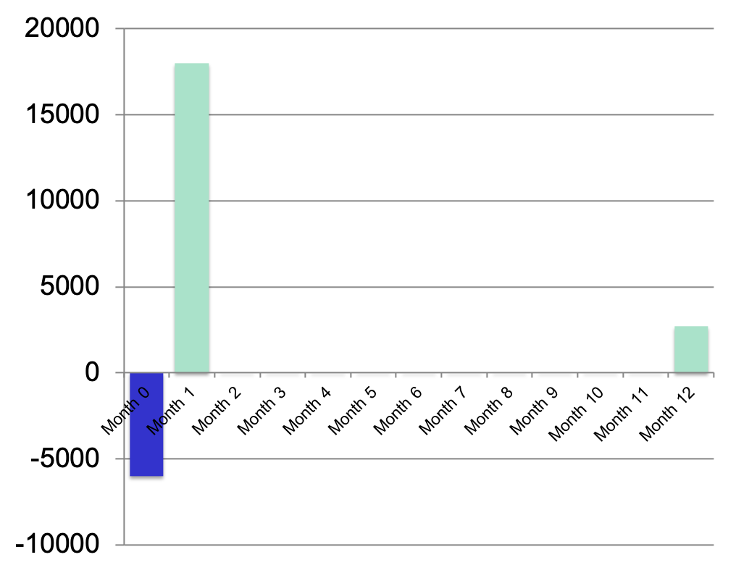
What we were used to: Licensed Software

Slide 16
What’s so different about SaaS?

Slide 17
Cash Impact of a typical deal
Negative Cash Flow

Slide 18
Unit Economics
A Powerful Tool

Slide 19
Unit Economics
Can I make more profit from my customers than it costs me to acquire them?

Slide 20
Unit Economics
CAC
LTV
CAC
LTV
Cost to Acquire a Customer
Lifetime Value of a Customer

Slide 21
A Viable Business Model
LTV
LTV
CAC
CAC
<
But surprising how many Entrepreneurs underestimate CAC

Slide 22
Basic Accounting
Understanding Key Terms
Introduce some Accounting Principles
Generate the following Financial Statements from the General Ledger
Income statement
Balance Sheet
Statement of Cash Flows
Statement of Ownership

Slide 23
Income Statement
The company’s profitability over a chosen period of time
Transactions are recorded using principles such as revenue and expense recognition, depreciation, amortization, and the matching principle.
(The matching principle is that expenses are matched with revenue)
The role of governing tax jurisdiction.

Slide 24
Balance Sheet: Assets
A Balance Sheet provides a "snapshot" of a company's financial position at a specific point in time.
Assets: ​Assets are resources owned by the company that have future economic value, such as Cash, Capital Equipment, and Accounts Receivable, etc..
​Accounts Receivable represent money owed to the company for services provided but not yet paid for. ​
Inventory is an Asset

Slide 25
Balance Sheet: Assets
Cost Principle: ​Assets are generally recorded at their original cost, and their recorded value is not increased even if their fair market value rises.
Conservatism Principle: ​Accountants may decrease an asset's value if its net realizable value falls below its original cost.
Example Goodwill
Depreciation: ​For assets with finite lives (e.g., vehicles, equipment), their cost is systematically allocated to Depreciation Expense on the Income Statement over their useful life to comply with the matching principle. ​For example, a $6,000 Computer with a two-year useful life might have $6,000/24 of Depreciation Expense matched to revenues each month. ​The "carrying amount" or "book value" of the asset on the balance sheet is its original cost minus accumulated depreciation.
​It's important to note that the balance sheet does not report assets at their current market value.

Slide 26
Balance Sheet: Liabilities
Liabilities: ​Liabilities are obligations or amounts owed to others as of the balance sheet date. ​
Examples
include loans (Notes Payable),
interest owed (Interest Payable),
amounts owed to suppliers (Accounts Payable),
and wages owed to employees (Wages Payable). ​
Money received in advance for services not yet performed is also a liability, recorded as Unearned Revenue.

Slide 27
Balance Sheet Stockholders Equity
Stockholders' Equity:
​For a corporation, this section represents the owners' interest in the company, calculated as assets minus liabilities.
It includes accounts like Common Stock (increased by owner investments)
and Retained Earnings (increased by profits and decreased by losses). ​
Net income increases stockholders' equity, while expenses decrease it, illustrating a link between the income statement and balance sheet. ​
Stockholders' equity is not equivalent to the corporation's market value or "net worth".

Slide 28
Statement of Cash Flows
The Statement of Cash Flows reports how a company's cash balance changed over a specific period.
It details cash generated and used by
operating,
investing,
and financing activities. ​

Slide 29
General Ledger
Detail List of all transactions

Slide 30
General Ledger and Chart of Accounts
Chart of Accounts: ​To organize transactions, a detailed listing of all possible accounts a business might use is created, known as a Chart of Accounts.
​
In the General Ledger, financial transactions are allocated to the account created by the Chart of Accounts.
This chart typically categorizes accounts into assets, liabilities, equity, revenues, and expenses.

Slide 31
Sample transaction
Prepaid expenses (Matching Principle)
Prepaid Rent: ​ The Company pays $1,500 for January rent in December.
​Cash (Asset account) is debited for $1,500 in December
Prepaid Expense (Asset Account) is credited for $1,500 in December
​The balance sheet remains in balance, with changes only on the asset side.

Slide 32
(spreadsheet)

Slide 33
Chart of Accounts
Group Headings
Revenue
Cost of Goods Sold
Engineering
Sales
Marketing
G&A
Interest expenses

Slide 34
Revenue
Sub Groups
Product
Service and Support
Subscription
Revenue Recognition Issues
GAAP Guidelines are murky
Backlogs or Bookings (not yet Recognized Revenues)
Deferred Revenue? Liability??

Slide 35
When should Revenue be recognized?
Contract is signed
Product or service is delivered
Invoice is sent out
When the bill is paid
Answer?
Example: Copy machine with 12 month maintenance contract sold in October
2 components Copy machine + 12 months of services

Slide 36
Cost of Goods Sold
Think of this as Variable Costs
All costs DIRECTLY involved in producing a product or service (Up to interpretation)

Slide 37
Expenses: Capital Expense vs Operating Expense
Remember Operating Expenses reduce the bottom line immediately
Temptation to classify operating expense as capital expense
Rule of thumb (not always observed)
Equipment less than 5,000 is expense
Greater than 5,000 is capital expense

Slide 38
Operating Expenses
Think of this as Fixed Costs
G&A
Engineering
Marketing
Sales

Slide 39
Engineering
Salary & Wages Expense
Engineers, VP Engineer, etc
Benefits
Travel
Contract Services
Information Technology Expense

Slide 40
G&A
Salary & Wages
CEO, CFO, Account, Admin
Office Expense
Travel
Bank Fees
Legal Expense
Corporate
Patent

Slide 41
Sales & Marketing
VP Sales and others
VP Marketing and Others
Trade Shows
Advertising
Lead Generation
Awareness

Slide 42
Definition of COGS
Cost of Revenue, Cost of Sales, Cost of Goods Sold (COGS)
Cost of goods sold (COGS for short) is the expense a company incurred in order to manufacture, create, or sell a product.
It includes the purchase price of the raw material as well as the expenses of turning it into a product.

Slide 43
Types of Accounts
Asset Accounts
Cash, Bank Accounts, Accounts Receivable, Equipment, Pre-Paid Expenses
Liability Accounts
Accounts Payable, Bank Loan, Accrued Interest
Equity Accounts
Revenue Accounts
Sales, Service, Support, Subscription
Expense
Utilities, travel, meals, insurance

Slide 44
CASH versus ACCRUAL and the Matching Principle
Accounting Method | Revenues Recognized | Expenses Recognized
CASH | Receipt of cash | Cash paid out
ACCRUAL | Product (shipped/invoiced) | Receipt of Invoice

Slide 45
Balance Sheet (Super Summary of the General Ledger)

Slide 46
Income Statement (P&L)

Slide 47
Income Statement and Balance Sheet

Slide 48
Cash-Flow and Balance Sheet

